Slide 1

VirtuaLgym
Turma 6, Grupo 5
Diogo Sousa, up202103341
José Santos, up202108673
Sara Azevedo, up202006902

Slide 2
Project abridged description
VirtualGym's goal is to facilitate the life of people that want to keep track of their fitness journey. It provides many features such as personalized workouts, reminders for the tasks you must do and tracking of your meals.
In this prototype, we aimed to display the main functionalities of VirtualGym mentioned above and defined three tasks with the intent of exploring these features:
Add two chest exercises, “Flat Bench Press” and “Push Ups”, both with 15 repetitions.
In nutrition, add “Cereals and milk” to the breakfast.
Create a reminder for 11/11 at 9:30 AM named “Workout”.

Slide 3
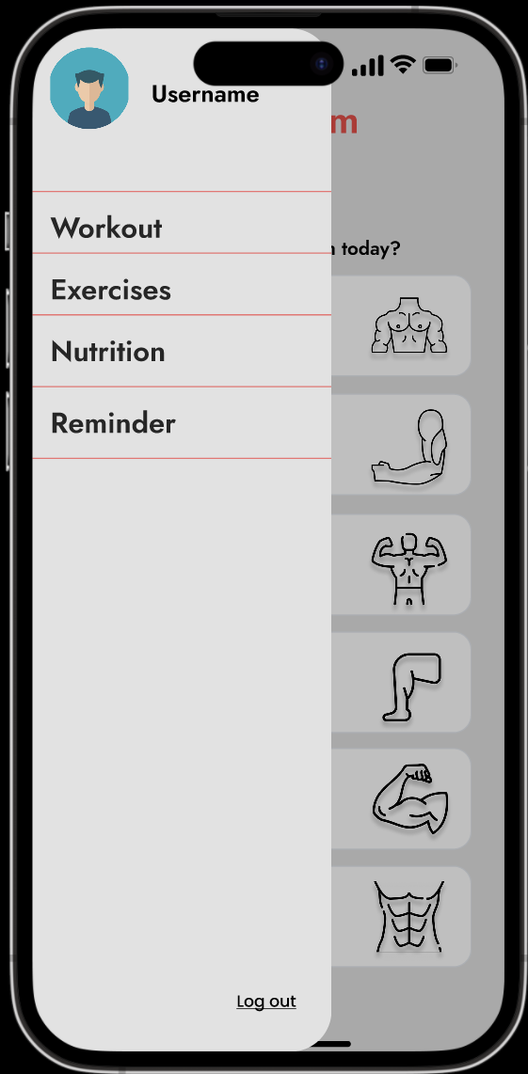
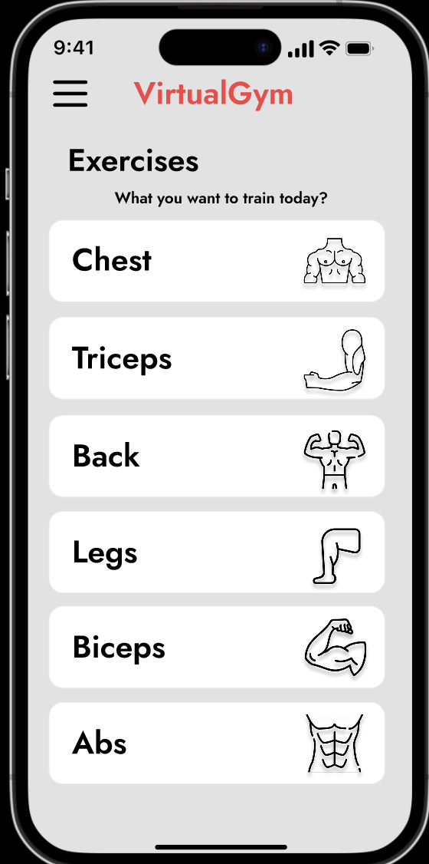
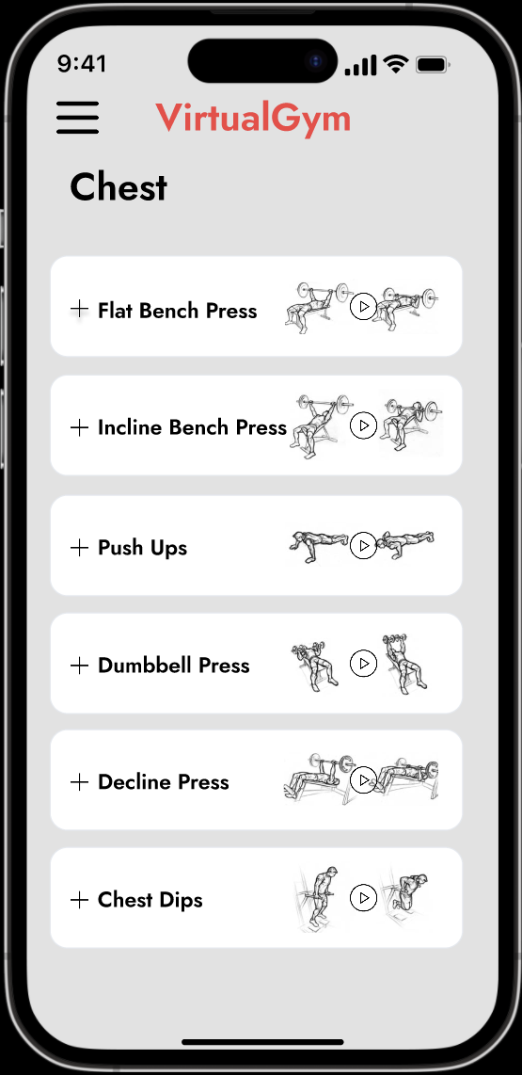
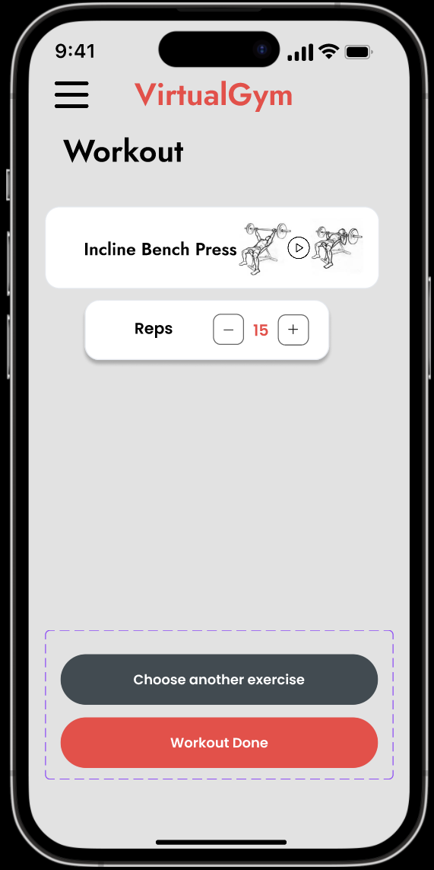
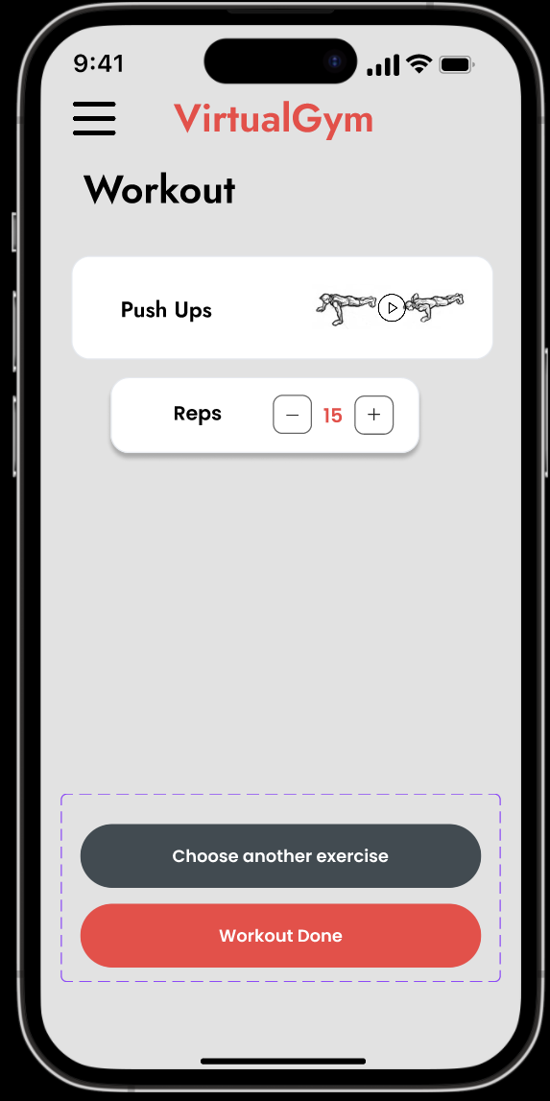
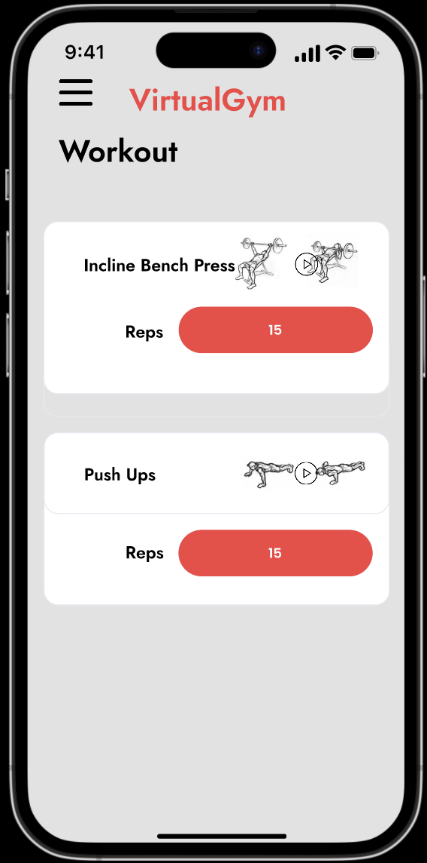
Prototype’s Wireflow
Task 1: Add two chest exercises, “Flat Bench Press” and “Push Ups” both with 15 repetitions.

Slide 4
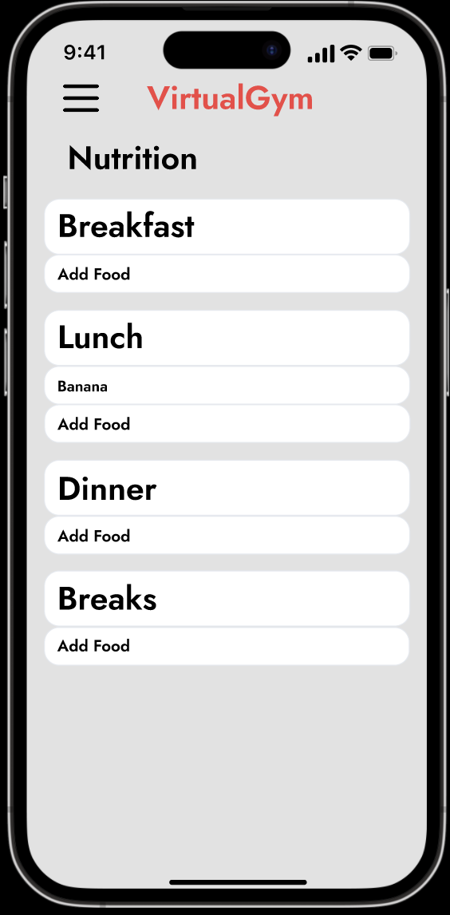
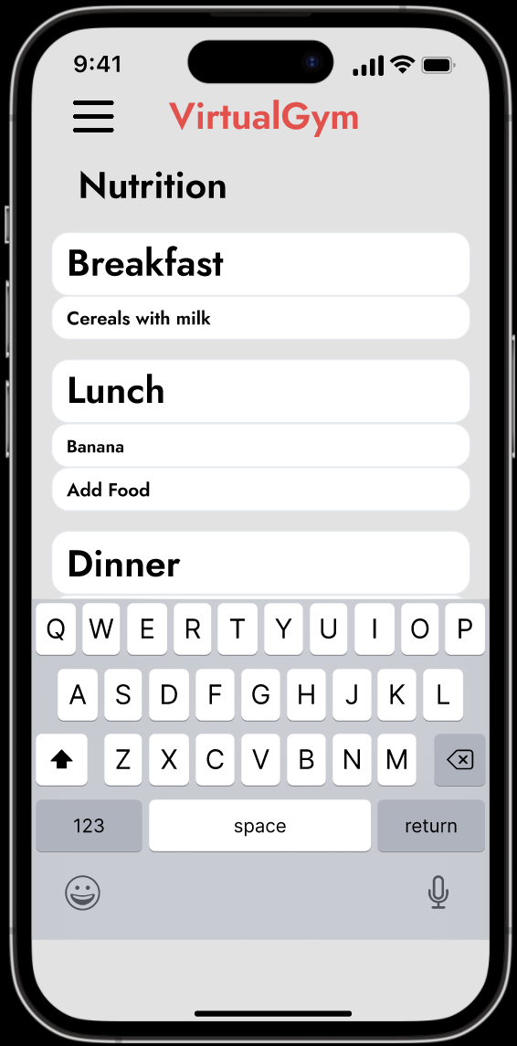
Prototype’s Wireflow
Task 2: In nutrition, add “Cereals and milk” to the breakfast.

Slide 5
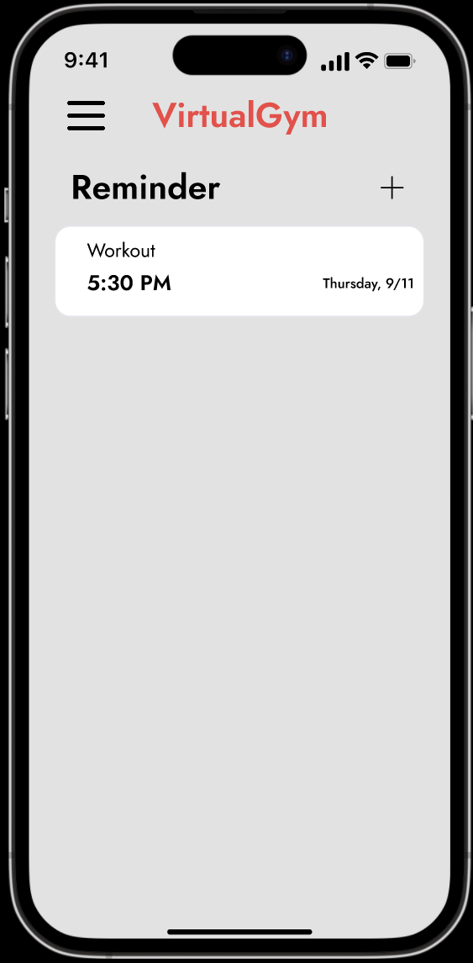
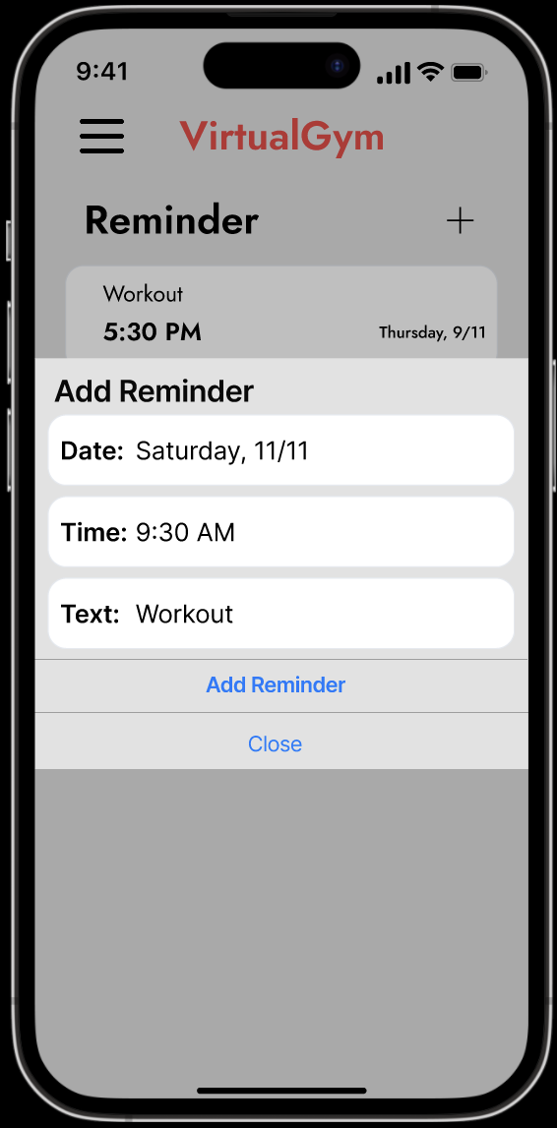
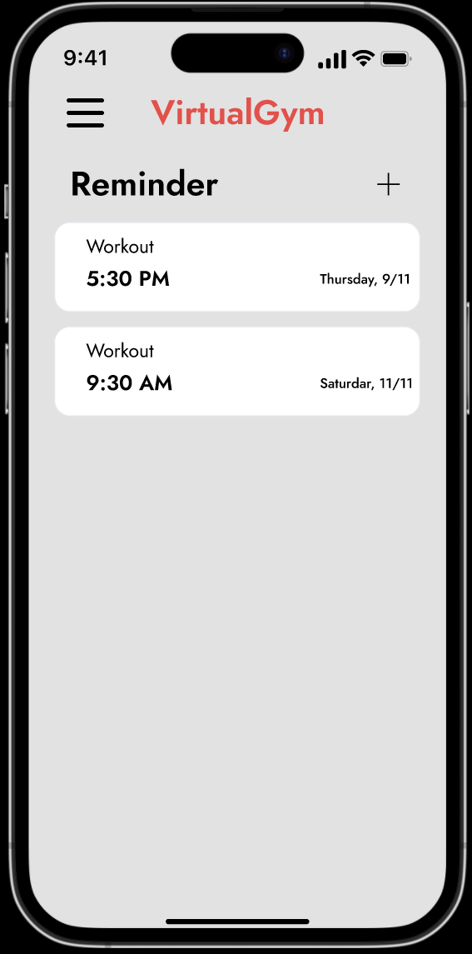
Prototype’s Wireflow
Task 3: Create a reminder for 11/11 at 9:30 AM named “Workout”.

Slide 6
Heuristic Evaluation Results
The main problems identified by the evaluators of group 4 were:
When adding both chest exercises to your training plan, do not it is possible to choose a different number for both despite the application suggests this possibility. Both keep the number of repetitions selected in the second exercise. (Severity 2)
When selecting the Flat Bench Press option in the application, it opens the Incline Bench Press exercise. (Severity 2)
On the Workout page there should be a note saying to add exercises to your Exercises page, as the user confused about how to do it in your first contact with the application. Furthermore, press Exercises present there do nothing. (Severity 1)
Unappealing design on the page dedicated to the user's meals. (Severity 1)
It should be possible to create more training plans, so that the user can organize plans by muscle, for example. (Severity 2)

Slide 7
Heuristic Evaluation Results
The main problems identified by the evaluators of group 6 were:
No HomeScreen when we start the prototype (We don’t know where we are). If we click the slogan instead of jumping to the homepage we jump to the exercises. (Severity 4)
We don’t know the difference between workout and exercises, because when we pick an exercise we jump directly to workout. It is better to have only one workout and have a button to add exercises instead of separating both of those things. (Severity 3)
For the nutrition page, we don’t know if the information changes everyday, maybe it is better to have an history of the nutrition, because the user didn´t know how long the felt out areas are staying. (Severity 3)
The picture with the play button is very confusing. The user didn´t know if there is a picture or a video you can click on. Because a play button is normally a standard for a video. (Severity 2)
The date of the reminder is a little bit too small. Date and Time is even important so it should be the same size. (Severity 1)

Slide 8
Corrections to perform in Phase 3
Based on the heuristic evaluation of both groups prior to our presented prototype, we came to the conclusion we must fix the most critical issues with it:
User Experience: Create a register/login page, that leads into an intuitive home page.
Workout Customization: Clarify the concept behind the personalized workouts and the exercises already defined for each muscle group, also fixing the rep counting button.
Nutrition Page: Add a history feature on the nutrition page, to help with the tracking of the user's diet.
Regarding the design aspects (severity 1), we acknowledge that it can improve, so we'll take care of that in the next phase, with a slightly lower priority.

Slide 9
VirtuaLgym

